Slide 1
Intro to Nautilus and Kubernetes
Coen Adler

Slide 2
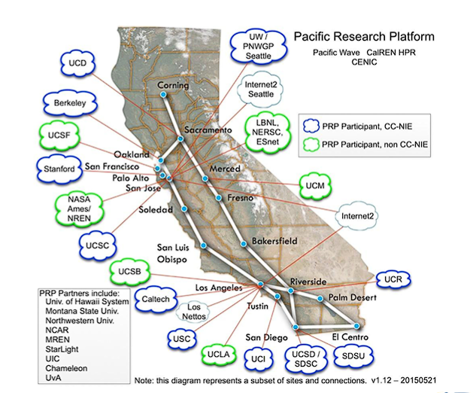
What is Nautilus?
Nautilus is an NSF funded hyperconverged cluster AKA a network of “super” computers

Slide 3

What is Kubernetes?
Kubernetes is an open-source container orchestration system.
This allows us to automate scaling and management for large computer systems
Interface for communicating with Nautilus Cluster (also can use JupyterHub)

Slide 4
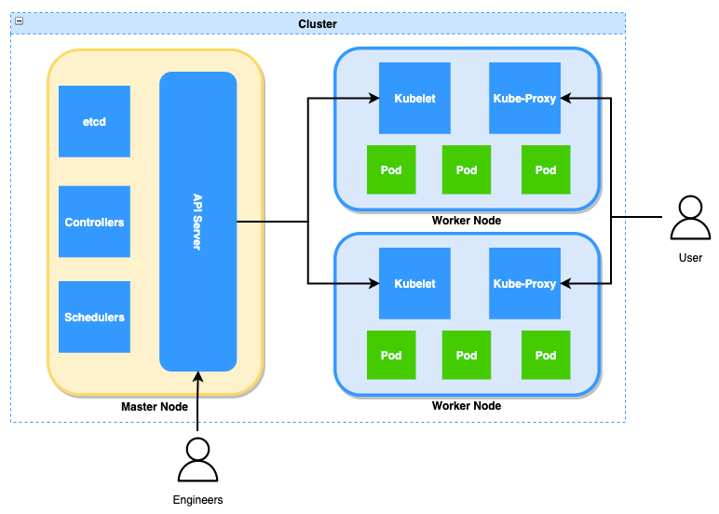
Important Vocabulary
Node
Physical Computer (not virtualized)
Pod
Most basic building block. Virtualized deployment unit (Virtual Machine)
Deployment
Controls the deployment/declaration of pods
Job
Creates pods until a task is completed
Persistent Volume Claims (PVC)
Persistent Storage, way to save data between pod shutdowns
Service
Logical abstraction for a deploying groups of pods (for a single function)

Slide 5
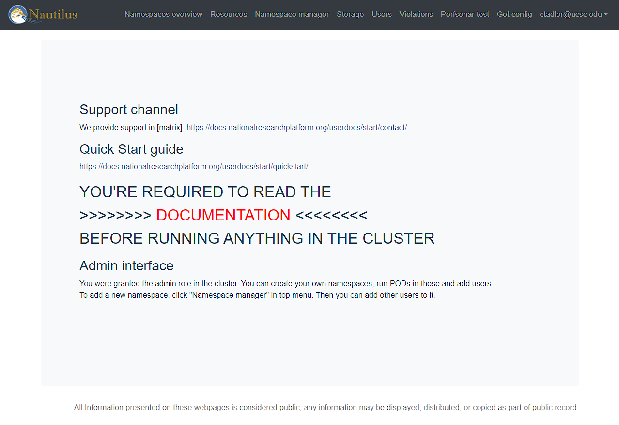
Prerequisites
Make sure to download all kubernete related software and create a nautilus account (plus more…)
Follow this Quick Start

Slide 6
Kubernetes Demo

Slide 7
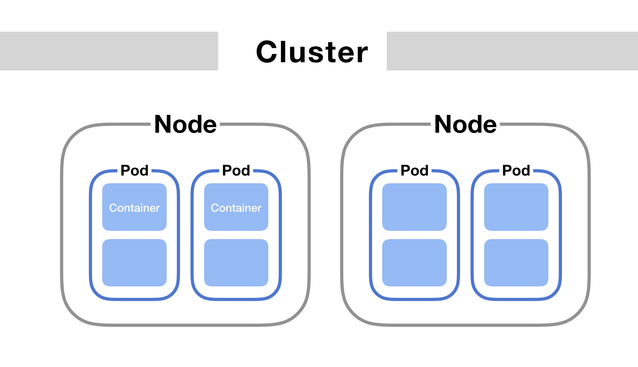
Introduction to Pods
Pods are the most basic deployable unit within a Kubernetes cluster
Think of them as Virtual Machines
You can create them manually
Only have ~6 hour lifespan
Use them for short tests or for loading data

Slide 8
Setting up a Pod
Create yaml file: testpod.yaml with the following lines
Line 2: tells Kubernetes what type of structure you are creating (in this case a pod)
Line 3/4: defines the name of the new pod
Line 8: The image is the version of OS the pod will be running
Lines 10-15: Expresses the resources we would like to request for our pod.
Line 16: When the pod opens what would we like it to do.
apiVersion: v1
kind: Pod
metadata:
name: test-pod
spec:
containers:
- name: mypod
image: centos
resources:
limits:
memory: 100Mi
cpu: 100m
requests:
memory: 100Mi
cpu: 100m
command: ["sh", "-c", "echo 'Im a new pod' && sleep infinity"]

Slide 9
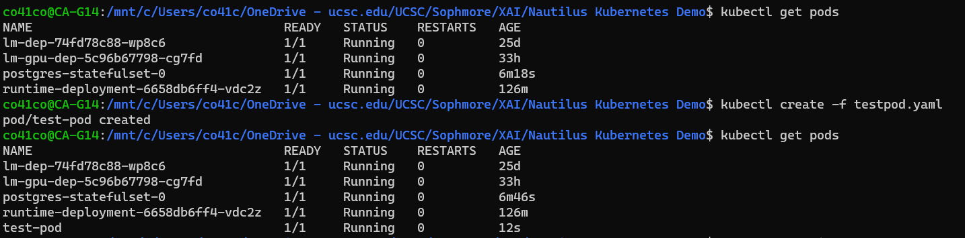
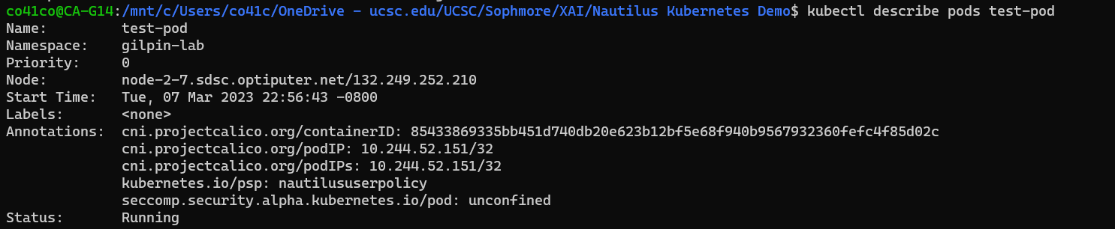
Creating a Pod

Slide 10
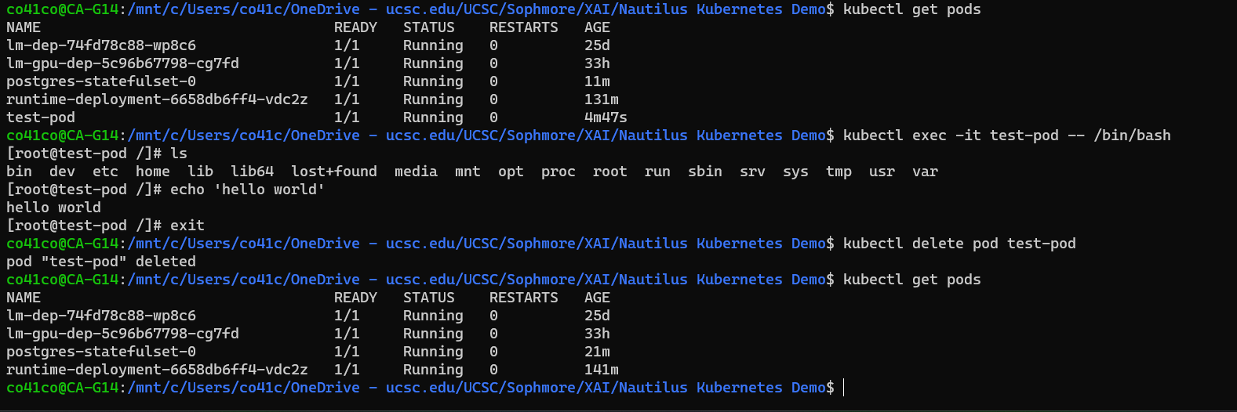
SSH onto a Pod

Slide 11
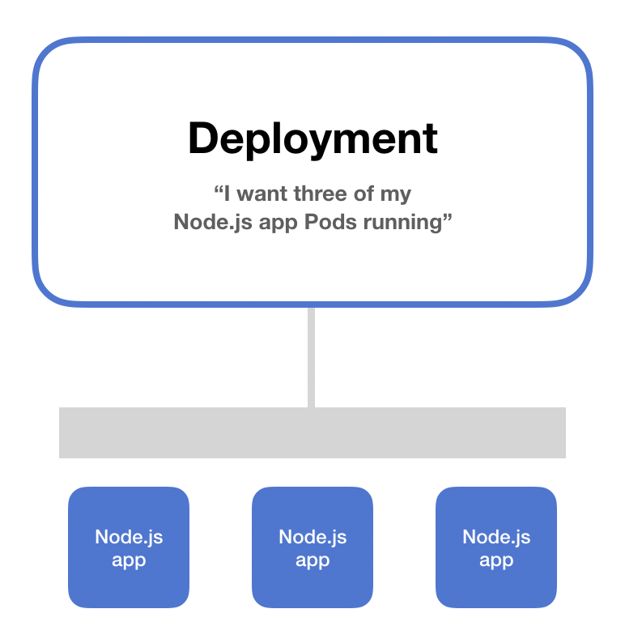
Intro to Deployments
Deployments tell how to create/modify instances of pods
Deployments are used to create pods and control how they are “deployed”
Will redeploy a pod if it “dies”
Deployments should be used to create pods that you need to SSH onto
Pods will have a ~2 week lifespan*

Slide 12
Setting up a Deployment
apiVersion: apps/v1
kind: Deployment
metadata:
name: test-dep
labels:
k8s-app: test-dep
spec:
replicas: 1
selector:
matchLabels:
k8s-app: test-dep
template:
metadata:
labels:
k8s-app: test-dep
spec:
containers:
- name: mypod
image: centos
resources:
limits:
memory: 500Mi
cpu: 500m
requests:
memory: 100Mi
cpu: 50m
command: ["sh", "-c", "sleep infinity"]
Create yaml file: testdep.yaml with the following lines
Line 7/8: says to create 1 copy of the k8s-app “test-dep”
Line 12-27: defines “test-dep” k8s-app
Notice we give a higher limit than requests

Slide 13
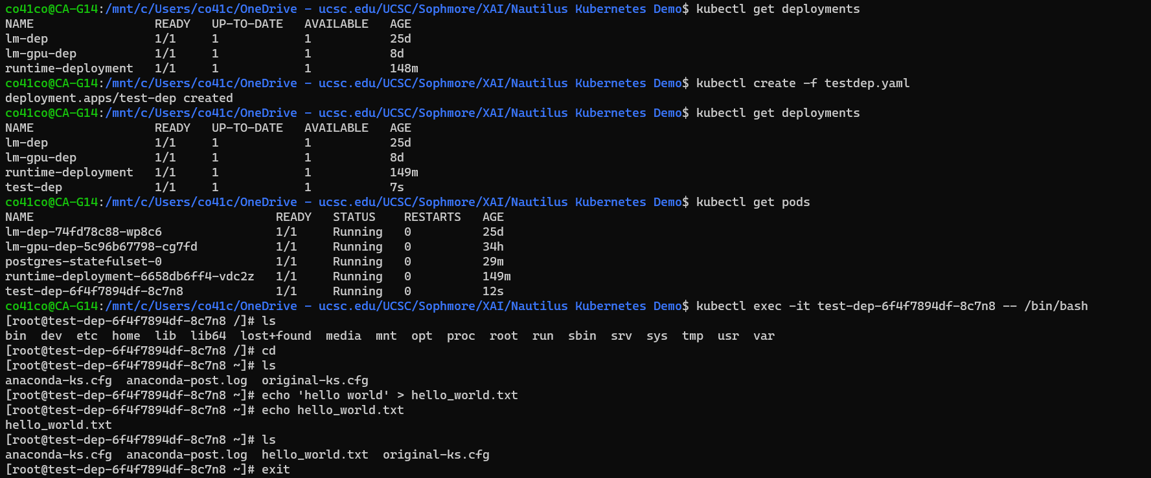
Creating a Deployment

Slide 14
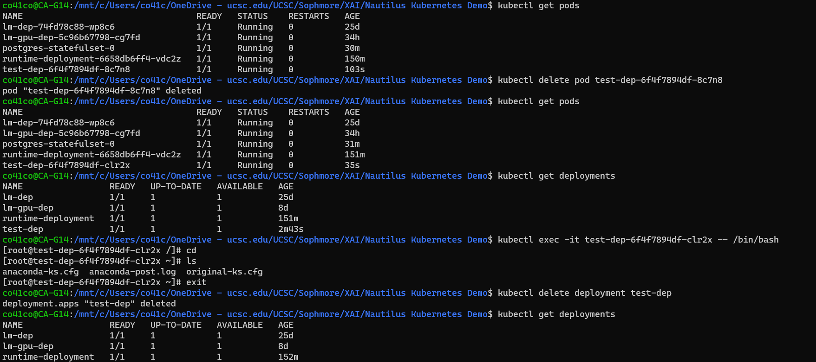
Deleting a Deployment Pod

Slide 15
Setting up a PVC
Create yaml file: testpvc0.yaml with the following lines
Notice that this is neither a pod or deployment but a Persistent Volume Claim
Under accessModes we have selected ReadWriteMany meaning we want to be able to read and write to this storage from multiple pods rather than it being only able to be accessed by one pod
Under resources we can see that we are requesting 16 GB of storage
apiVersion: v1
kind: PersistentVolumeClaim
metadata:
name: test-vol0
spec:
storageClassName: rook-cephfs
accessModes:
- ReadWriteMany
resources:
requests:
storage: 16Gi

Slide 16
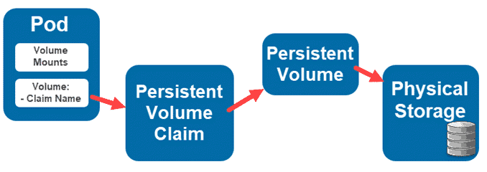
Intro to Persistent Volume Claims (PVC)
Pods will lose their memory/storage when destroyed
Use PVCs to store data between pods
Connect PVCs to pods to be able to easily transfer/store data

Slide 17
Setting up a PVC
apiVersion: v1
kind: Pod
metadata:
name: test-pod0
spec:
containers:
- name: mypod
image: centos:centos7
command: ["sh", "-c", "sleep infinity"]
resources:
limits:
memory: 100Mi
cpu: 100m
requests:
memory: 100Mi
cpu: 100m
volumeMounts:
- mountPath: /pvcvolume
name: examplevol
volumes:
- name: examplevol
persistentVolumeClaim:
claimName: test-vol0
apiVersion: v1
kind: Pod
metadata:
name: test-pod1
spec:
containers:
- name: mypod
image: centos:centos7
command: ["sh", "-c", "sleep infinity"]
resources:
limits:
memory: 100Mi
cpu: 100m
requests:
memory: 100Mi
cpu: 100m
volumeMounts:
- mountPath: /pvcvolume
name: examplevol
volumes:
- name: examplevol
persistentVolumeClaim:
claimName: test-vol0
2. Set up 2 Pods to read from the PVC (testpvcpod0.yaml | testpvcpod1.yaml)
We can attach the pvc through volumes
Mount the pvc to the pod’s file system with volumeMounts (mountPath)

Slide 18
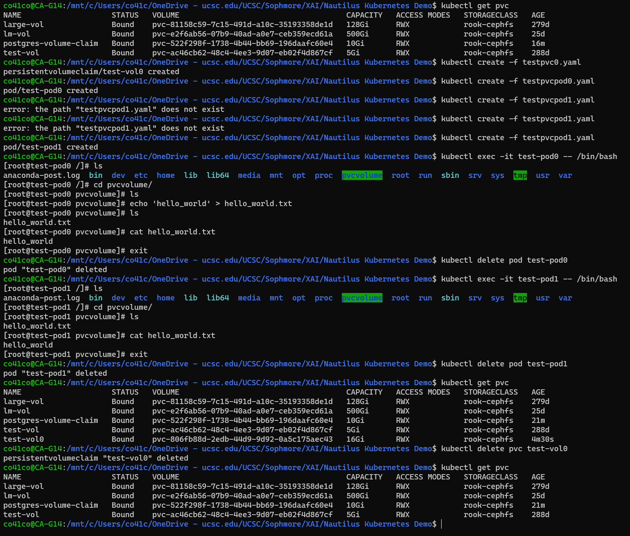
Creating a PVC

Slide 19
Saving Files using PVC

Slide 20
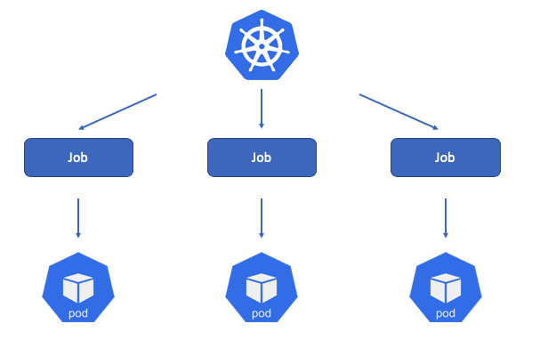
Intro to Jobs
DO NOT USE THE COMMAND `SLEEP INFINITY` in your Job!
Jobs will continuously try to create pods until a successful execution of the given commands
Will fail after a specified number of failures
Use jobs for large scale testing
Pipeline is built in
Jobs don’t have a max lifespan*

Slide 21
Setting up a Job
apiVersion: batch/v1
kind: Job
metadata:
name: testjob
spec:
template:
spec:
containers:
- name: demo
image: gitlab-registry.nrp-nautilus.io/prp/jupyter-stack/prp:latest
command:
- sh
- -c
- "cd /persistentvol && python decisiontree.py"
volumeMounts:
- name: persistentvol
mountPath: /persistentvol
resources:
limits:
memory: 16Gi
cpu: "4"
requests:
memory: 8Gi
cpu: "2"
volumes:
- name: persistentvol
persistentVolumeClaim:
claimName: test-vol1
restartPolicy: Never
backoffLimit: 5
Create yaml file: testjob.yaml with the following lines
Give a set of commands to run, in this case a python file located in an attached PVC
BackoffLimit sets the number of times to restart pod on failure

Slide 22
Setting up a PVC/Pod
apiVersion: v1
kind: Pod
metadata:
name: test-pod1
spec:
containers:
- name: mypod
image: centos:centos7
command: ["sh", "-c", "sleep infinity"]
resources:
limits:
memory: 100Mi
cpu: 100m
requests:
memory: 100Mi
cpu: 100m
volumeMounts:
- mountPath: /pvcvolume
name: examplevol
volumes:
- name: examplevol
persistentVolumeClaim:
claimName: test-vol1
We create a PVC and Pod to bound the PVC to
We can use the Pod to upload data to the PVC for use in the job
apiVersion: v1
kind: PersistentVolumeClaim
metadata:
name: test-vol1
spec:
storageClassName: rook-cephfs
accessModes:
- ReadWriteMany
resources:
requests:
storage: 16Gi

Slide 23
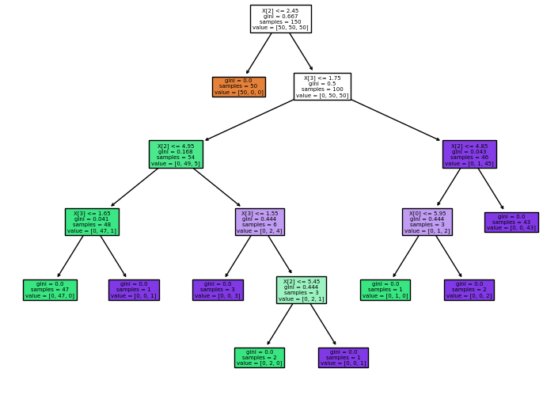
Fun Decision Tree Script
Create python file: decisiontree.py with the following lines
Imports iris flower dataset and builds a decision tree classifier using sklearn
Saves a picture of the built decision tree into directory
from sklearn.datasets import load_iris
from sklearn import tree
import matplotlib.pyplot as plt
iris = load_iris()
X, y = iris.data, iris.target
clf = tree.DecisionTreeClassifier()
clf = clf.fit(X, y)
plt.figure()
tree.plot_tree(clf,filled=True)
plt.savefig('tree.png',bbox_inches = "tight")

Slide 24
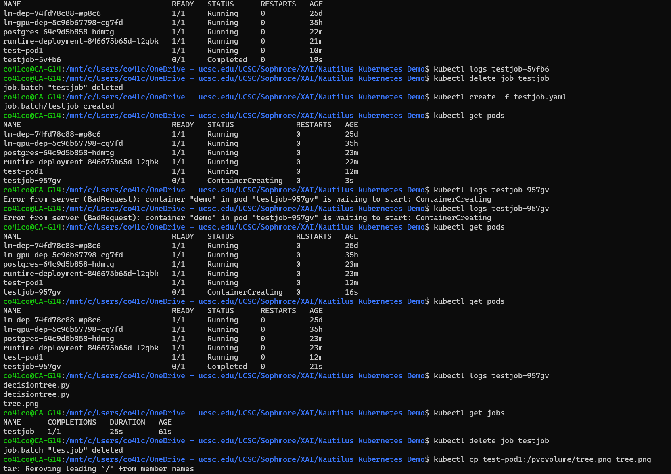
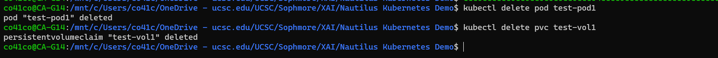
Creating a Job

Slide 25
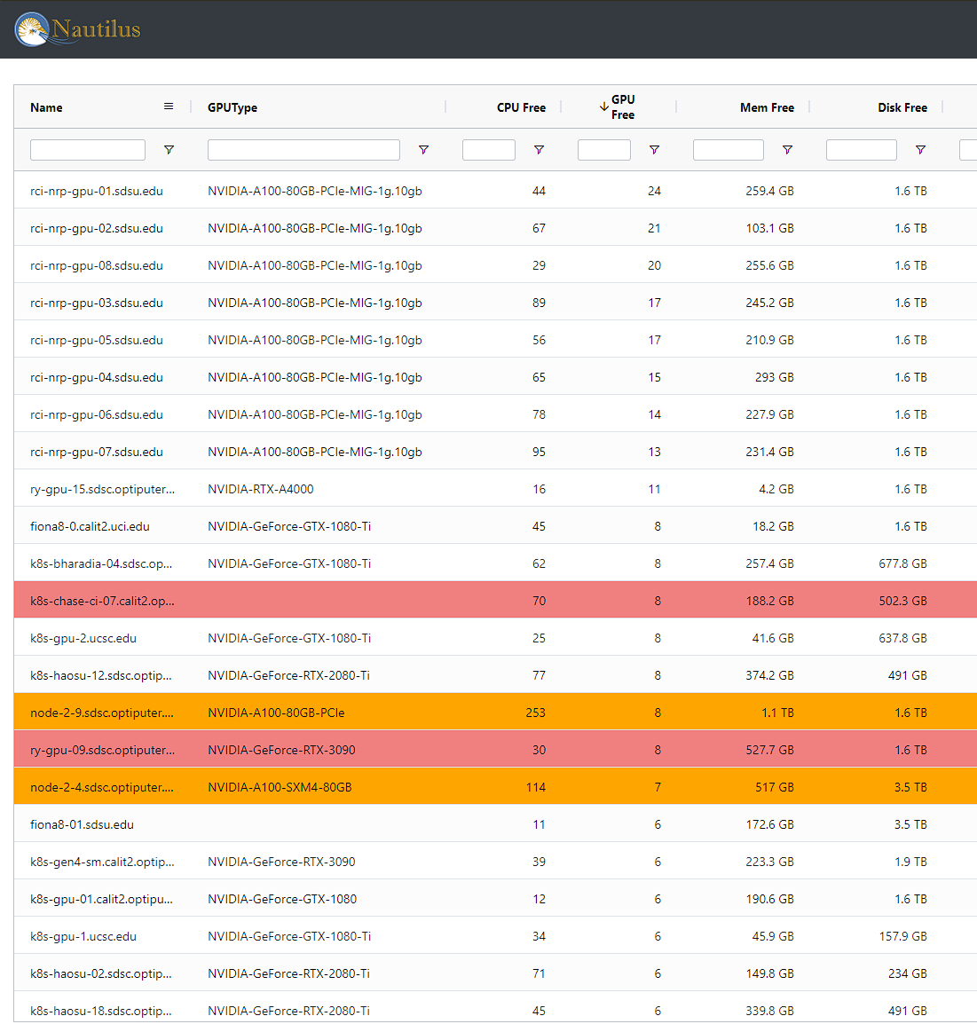
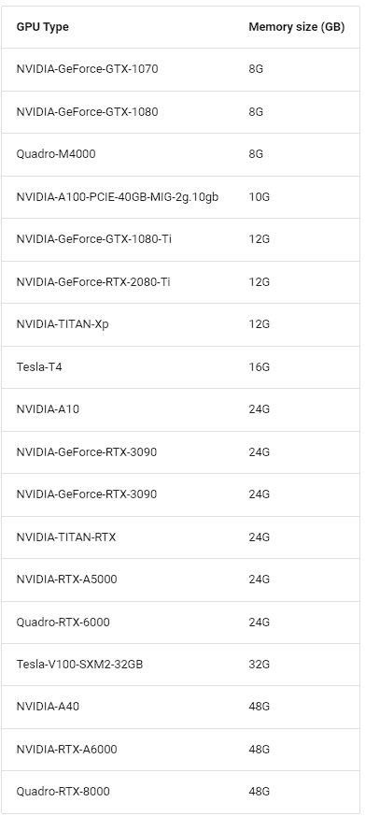
Using GPUS
One of the main reason to use Nautilus is to get access to GPUs
To see what GPUs are available use this resource link
You can use any us-west Region Node/Machine
Or you can use Leilani’s…

Slide 26
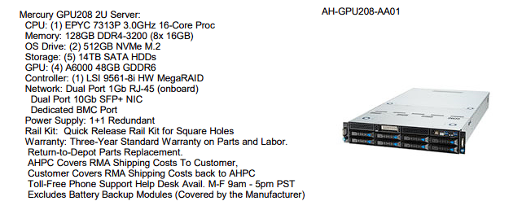
AIEA Lab Computer
4 NVIDIA A6000 GPUs
128 GB RAM
14 TB Storage
AMD EPYC 16-Core CPU
PLUS, we get priority for using it!

Slide 27
Using GPUs and AIEI Lab Node
apiVersion: v1
kind: Pod
metadata:
name: xaimachinetest
spec:
containers:
- name: demo
image: gitlab-registry.nrp-nautilus.io/prp/jupyter-stack/prp:latest
command: ["sh", "-c", "sleep infinity"]
resources:
limits:
memory: 16Gi
cpu: "4"
nvidia.com/gpu: "1"
requests:
memory: 16Gi
cpu: "2"
nvidia.com/gpu: "1"
affinity:
nodeAffinity:
requiredDuringSchedulingIgnoredDuringExecution:
nodeSelectorTerms:
- matchExpressions:
- key: kubernetes.io/hostname
operator: In
values:
- k8s-gpu-5.ucsc.edu
- key: nvidia.com/gpu.product
operator: In
values:
- NVIDIA-RTX-A6000
tolerations:
- effect: NoSchedule
key: nautilus.io/gilpin-lab
operator: Exists
To use GPUs make sure to include it in the resources section
You can use the lines from “affinity” and below to identify that you want our specific machine
If you don’t want our machine check these examples
spec:
affinity:
nodeAffinity:
requiredDuringSchedulingIgnoredDuringExecution:
nodeSelectorTerms:
- matchExpressions:
- key: nvidia.com/gpu.product
operator: In
values:
- NVIDIA-GeForce-GTX-1080-Ti

Slide 28
THANK YOU
Please use Nautilus!
Questions?
Coen Adler
ctadler@ucsc.edu

